Slide 1
-Predicting financial distress-
Team 10
Team Member1 (윤희경, 2011120355)
Team Member2 (김병건, 2011210030)
Team Member3 (조유현, 2011210049)
Notes:
-

Slide 2
Project Goal
We had to change the subject because we could not collect data because of security problems.
Our project Goal is Improving on the state of the art in credit scoring by predicting the probability that somebody will experience financial distress in the next two years.
It will use 11 kinds of historical credit information.

Slide 3
Time Schedule (Changed)
Month | Week | To do
April | Week 2 | Get raw data
 | Week 3
 | Week 4 | Mid-term exam
 | Week 5 | - * Subject change
May | Week 1 | Process the raw data into DataFrame - Inferential Statistics Analysis
 | Week 2 | - plan implementation
 | Week 3 | Implementations
 | Week 4 | Report
June | Week 1 | Presentations
 | Week 2 | Presentations
 | Week 3 | Final exam

Slide 4
Team’s progress (1)
To training, we analyzed all patterns of data.
How did you find these patterns from the data?
1 . We drew a graph using all the data(100% data each).
2 . To obtain a more meaningful patterns Remove the outer side of the data and then draw a graph using the portions of the data.
I'll show you examples later page.

Slide 5
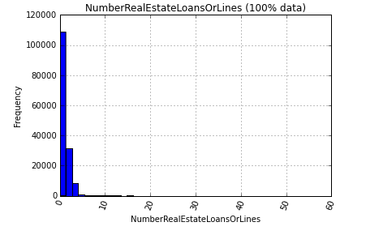
Team’s progress (2)
As one of the 11 types of data,
Let's look at “NumberRealEstateLoansOrLines”
“NumberRealEstateLoansOrLines Using 100% data” has a large number of small amounts of data.

Slide 6
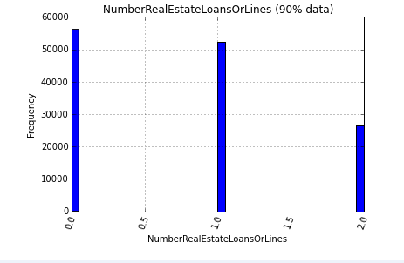
Team’s progress (3)
Remove the outer side of the data and then draw a graph using the portions of the data.
“NumberRealEstateLoansOrLines Using 90% data” represents a more meaningful graphs.
We can infer that 90% of people have no more than two RealEstateLoansOrLines.

Slide 7
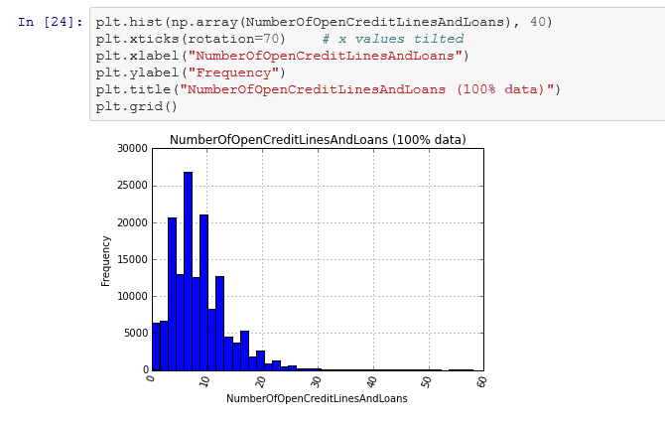
Team’s progress (4)
NumberOfOpenCreditLinesAndLoans (100% data)

Slide 8
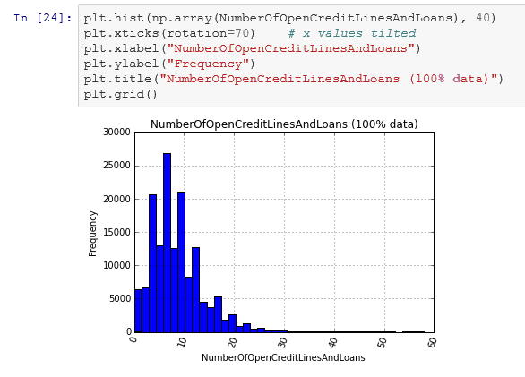
Team’s progress (5)
NumberOfOpenCreditLinesAndLoans (95% data)

Slide 9
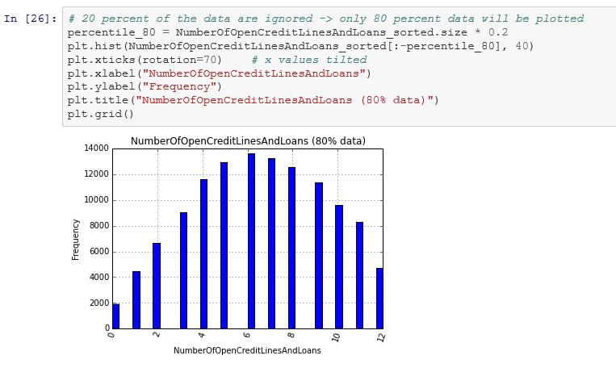
Team’s progress (6)
NumberOfOpenCreditLinesAndLoans (80% data)

Slide 10
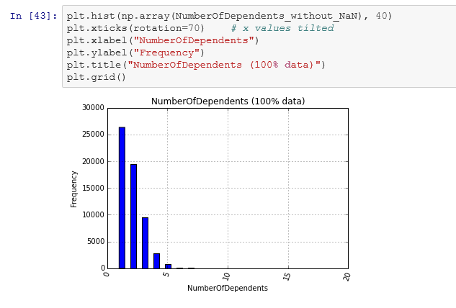
Team’s progress (7)
NumberOfDependents (100% data)

Slide 11
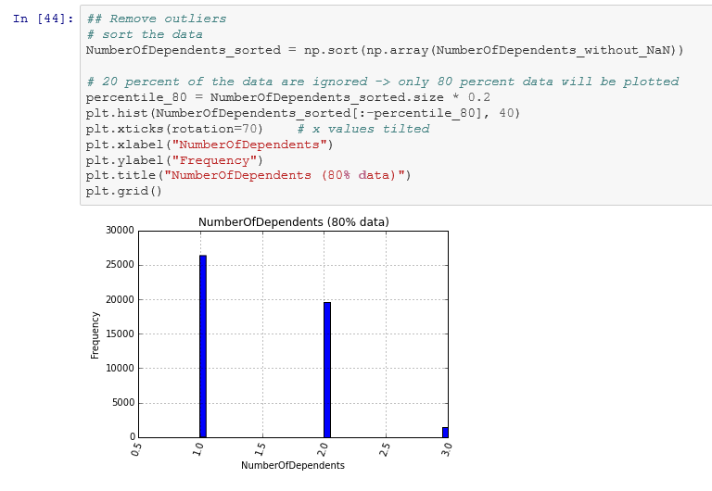
Team’s progress (8)
NumberOfDependents (80% data)

